Slide 1
Basic Syntax Of Python
Class day 1

Slide 2
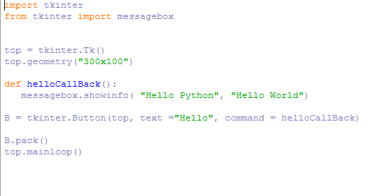
Basic Syntax
string = "hello"
print(string)

Slide 3
Python Identifiers
An identifier starts with a letter A to Z or a to z or an underscore (_) followed by zero or more letters, underscores and digits (0 to 9).
Python does not allow punctuation characters such as @, $, and % within identifiers.

Slide 4
Here are naming conventions for Python identifiers −
Class names start with an uppercase letter. All other identifiers start with a lowercase letter.
Starting an identifier with a single leading underscore indicates that the identifier is private.
Starting an identifier with two leading underscores indicates a strongly private identifier.
If the identifier also ends with two trailing underscores, the identifier is a language-defined special name.

Slide 5
Key Word List
and | exec | not
assert | finally | or
break | for | pass
class | from | print
continue | global | raise
def | if | return
del | import | try
elif | in | while
else | is | with
except | lambda | yield

